Slide 1

Educate the Force:
Enlisted Promotions

Slide 2
Purpose
  Educate the enlisted force, starting at the lowest level, with the goal to improve understanding and knowledge regarding the MOARNG enlisted promotion system (EPS).

Slide 3
References
AR 600-8-19, Enlisted Promotions and Reductions
NGR 600-200, Enlisted Personnel Management
FY26 Enlisted Promotion System (EPS) Memorandum of Instruction (MOI)
MONGR 600-200, Enlisted Career Management Standard Operating Procedures

Slide 4
Recent EPS Updates
SGT board will ONLY utilize administrative points (800 maximum)
SSG board will utilize administrative points (800 maximum) AND leadership points (250 maximum)
Voting rubric utilized for SSG, SFC, MSG, 1SG, SGM and CSM EPS boards
Temporary Promotions Eliminated
Distributed Learning Courses (DLC) I-VI have been eliminated

Slide 5
Responsibilities
Individual Soldier:
It is the responsibility of the Soldier to meet all eligibility requirements and to ensure that their record is up-to-date. If eligible, Soldiers will make their elections in IPPS-A and complete an EPS board consideration packet with the assistance of their first line leader (FLL) and full-time support personnel (FTS). A letter to the president of the board will need to be included to address any missing or erroneous documents in the Soldiers record.

Slide 6
Responsibilities
First Line Leader (FLL):
It is the responsibility of the FLL to ensure that their Soldiers are prepared by complying with the current published criteria. FLLs will assist in reviewing their Soldier’s records and preparing their EPS consideration packets. Assistance from FTS personnel is encouraged. FLLs must periodically counsel their Soldiers and provide accurate evaluations IAW AR 623-3 and DA PAM 623-3.
Full-Time Support (FTS) Personnel:
It is the responsibility of the FTS personnel to provide guidance and assist Soldiers and FLLs for accuracy and completeness of the EPS packets. They will prepare the finished copies ready for signatures and ensure that suspense dates are met. FTS personnel are responsible for ensuring that all documentation for personnel records updates are processed in a timely manner to ensure updates within the systems are completed prior to the promotion boards convening.

Slide 7
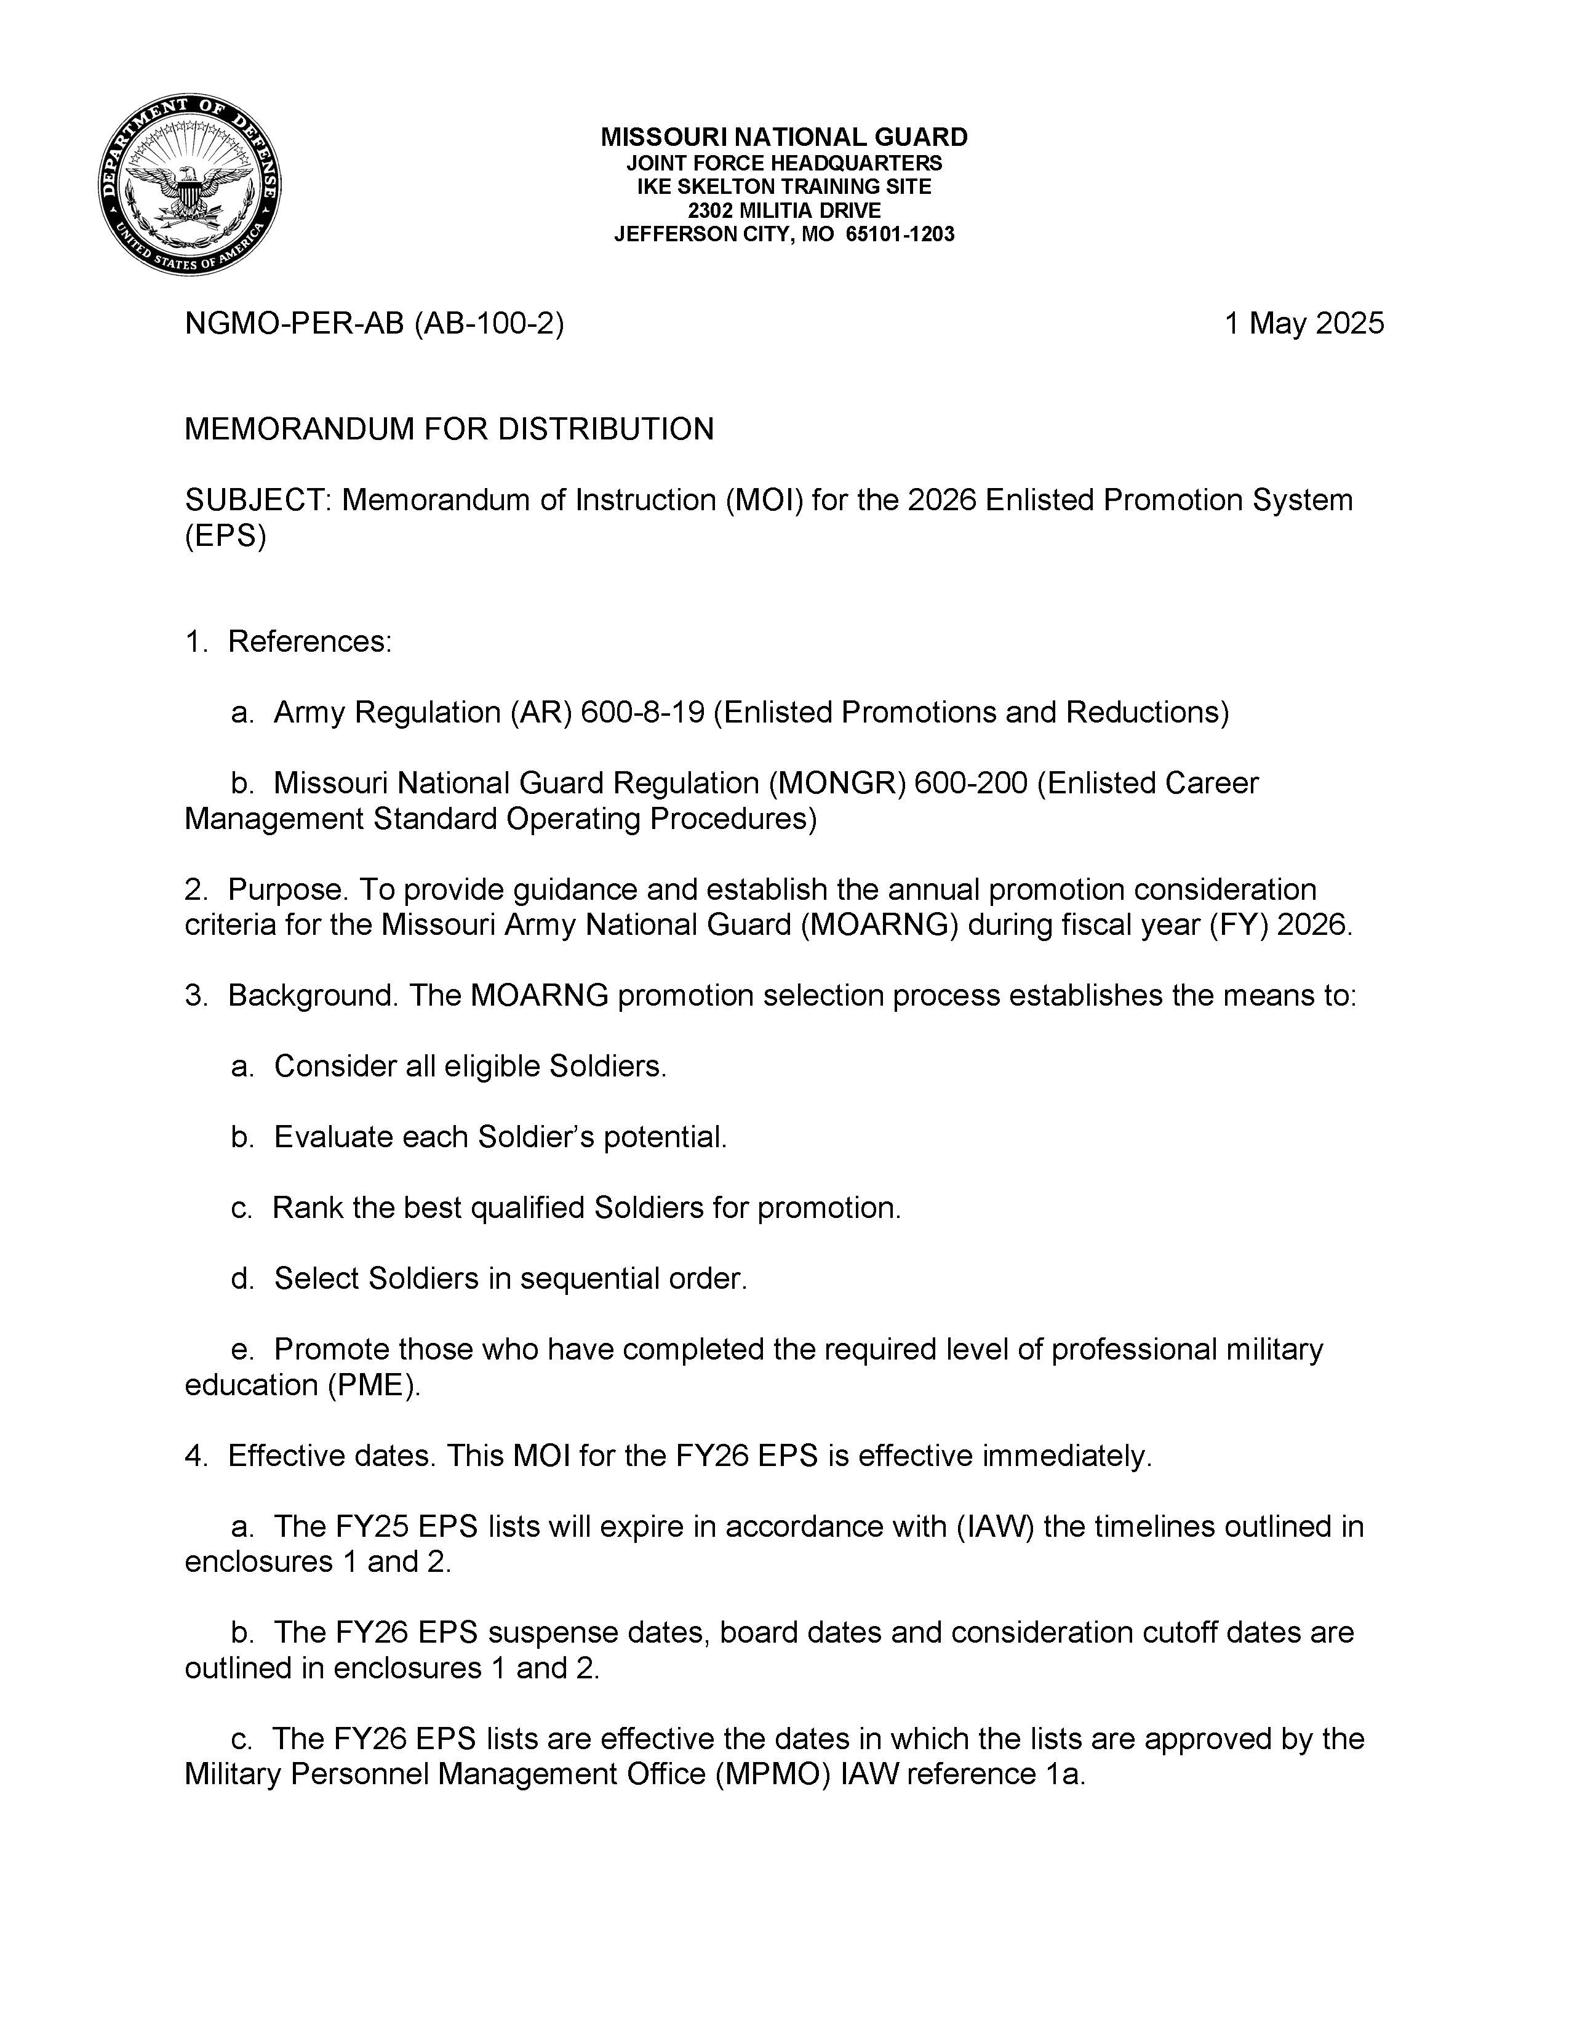
FY26 EPS MOI

Slide 8
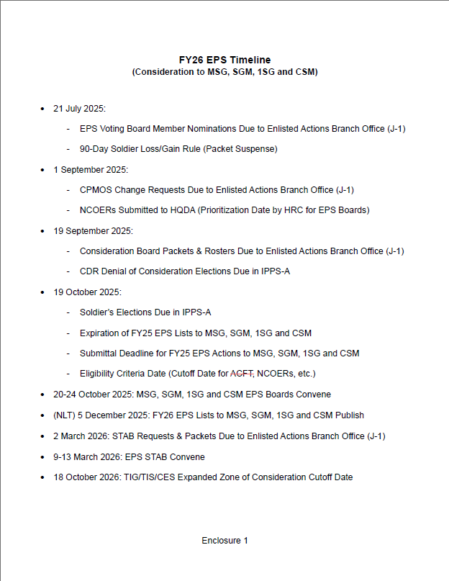
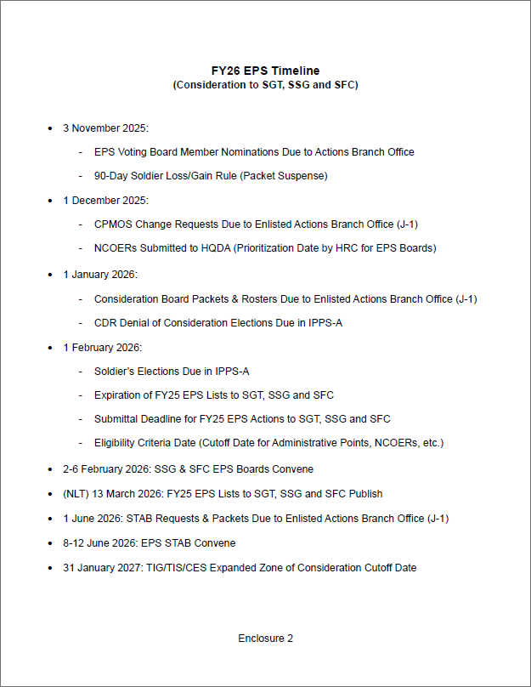
EPS Timelines

Slide 9
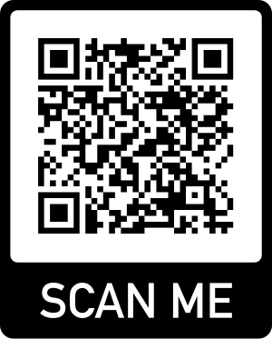
Vacancies and Position Opportunities
All referenced material can be found on the Missouri National Guard Website:

Slide 10
What is a Statewide Vacancy Announcement?

Slide 11
Statewide Vacancy Announcements (SWVA)
Designed to fill critical NCO vacancies which are unable to be filled through the EPS list
SGT-SGM vacancies are advertised statewide and can be found/received through email, the Missouri National Guard website, and your unit’s bulletin board
Soldiers that are 2 grades below the authorized grade for the advertised vacancy are authorized to apply
If selected, Soldiers that are not duty MOS qualified must agree to become duty MOS qualified within 1 year

Slide 12
Statewide Vacancy Announcements (SWVA)
Soldiers selected by SWVA must meet the following requirements for promotion:
Duty MOS qualified
  PME complete for the applicable higher grade
  EPS list status

Slide 13
Automatic Promotions
For the ranks of:
Private Enlisted Two (PV2) – 6 months TIS
Private First Class (PFC) – 12 months TIS & 4 months as PV2
Specialist (SPC) – 24 months TIS & 6 months as PFC
Automatically processed by IPPS-A
Soldiers must be in good standing
Commanders may deny automatic promotions before a Soldier attains eligibility

Slide 14
Automatic Promotion Waivers
Commanders are authorized to waive TIS & TIG requirements to a lesser timeframe
For the ranks of:
Private Enlisted Two (PV2) – 4 months TIS
Private First Class (PFC) – 6 months TIS & 2 months as PV2
Specialist (SPC) – 18 months TIS & 3 months as PFC

Slide 15
Career Progression MOS (CPMOS)
By default, a Soldier’s CPMOS is their primary MOS. CPMOS is always for next grade, per CMF charts in DA PAM 611-21
If a Soldier wishes to compete in a different MOS that they are qualified in, a CPMOS change request is required
No matter if the Soldier was approved last cycle, must request again for this cycle. Only J-1 (COL Decker) can approve CPMOS Change Requests (paragraph 6-29d(2)(a) of AR 600-8-19)
EPS MOI timeline consists of CPMOS change submittal deadlines for each board.
Requests for CPMOS changes can only be submitted/approved during the pre-board process. After the deadline passes, Soldiers can only be moved from one CPMOS to another if they are placed into a different position with a different MOS in which they are qualified for (primary MOS matches duty position MOS)

Slide 16
Requesting EPS Board Consideration
All referenced material can be found on the Missouri National Guard Website:

Slide 17
EPS Consideration Step # 1
EPS Board | TIG (Time in Grade) | TIS (Time in Service) | CES (Cumulative Enlisted Service) | Military Education Required
E-9 (SGM & CSM) | 36 months | 16 years | 10 years | Must have graduated Master Leader Course (MLC) (exceptions to this requirement if promoted to E-8 prior to 1JAN19) and must be eligible to attend and complete the Sergeants Major Course (USASMC).
E-8 (MSG & 1SG) | 36 months | 12 years | 8 years | Must have graduated Advanced NCO Course (ANCOC) or Senior Leader Course (SLC).
E-7 (SFC) | 36 months | 8 years | 6 years | Must have graduated Basic NCO Course (BNCOC) or Advanced Leader Course (ALC).
E-6 (SSG) | 18 months | N/A | N/A | Must have graduated Primary Leadership Development Course (PLDC), Warrior Leader Course (WLC) or Basic Leader Course (BLC).
E-5 (SGT) | 12 months | N/A | N/A | There is no PME requirement for promotion board eligibility or pin-on.

Slide 18
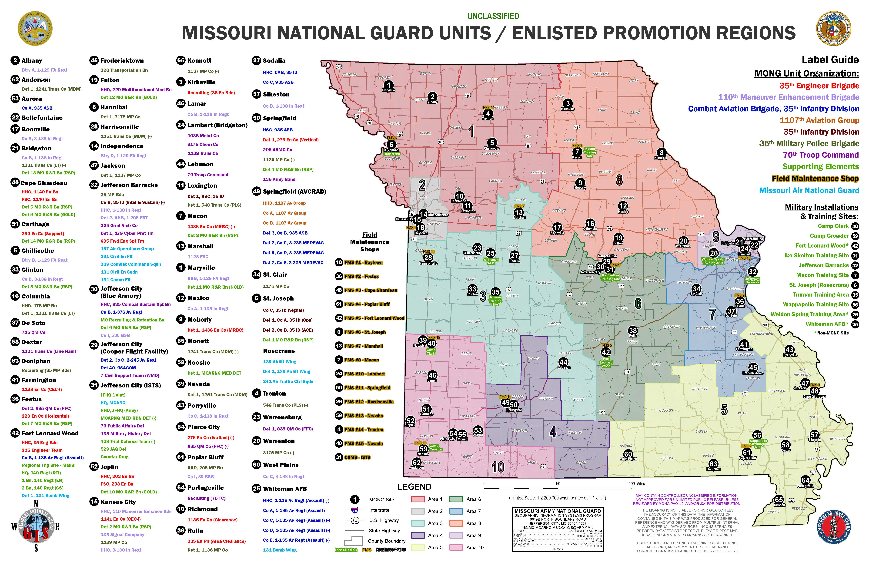
EPS Consideration Step # 2

Slide 19
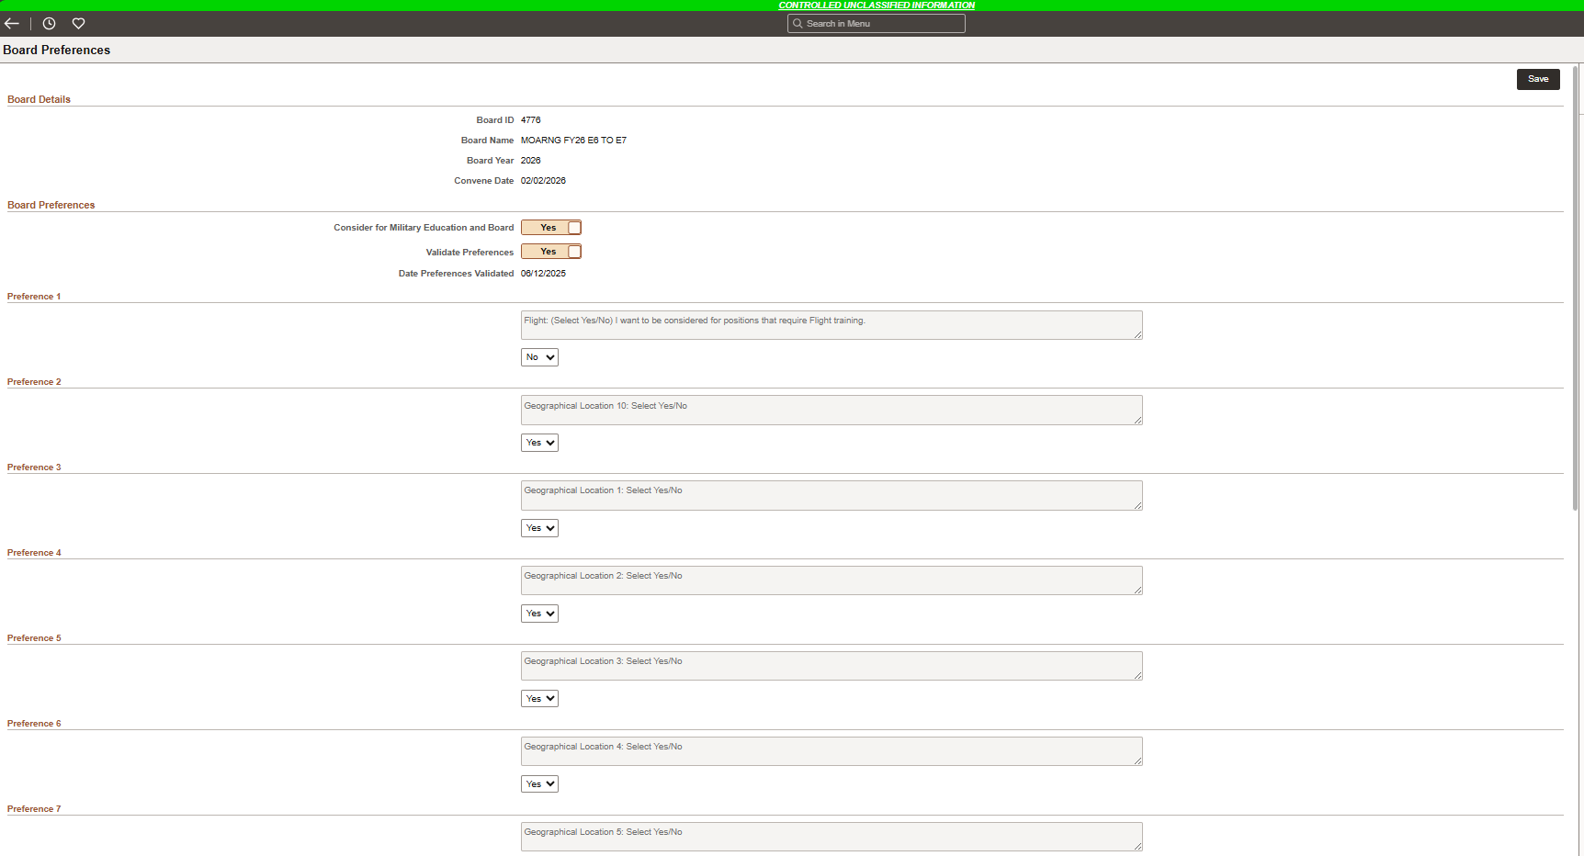
EPS Consideration Step # 2
  Go to IPPS-A → “Self Service” page → click “Board Preferences USAR/ARNG”

Slide 20
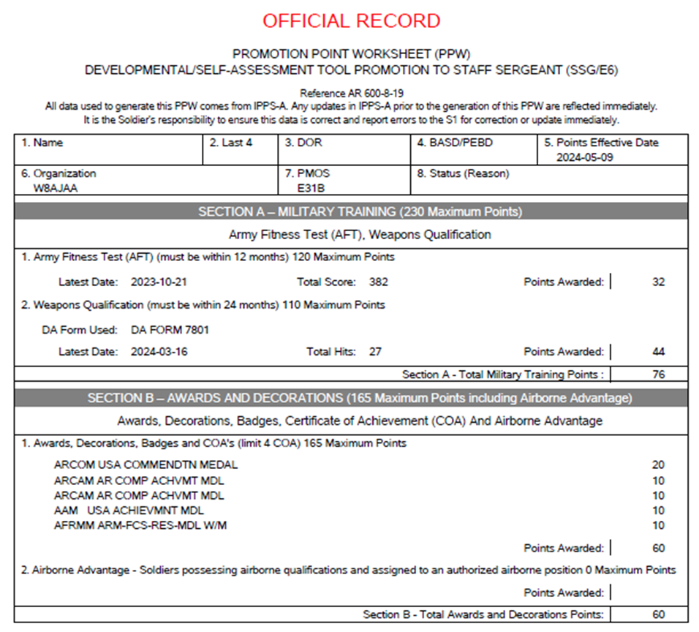
EPS Consideration Step # 3
  Consideration to SGT and SSG ONLY:
  Calculate your administrative points in your IPPS-A profile (guide available in the MONGR 600-200) and validate (with FTS) that the correct number of points are reflected on the personnel eligibility roster and promotion point worksheet (PPW)

Slide 21
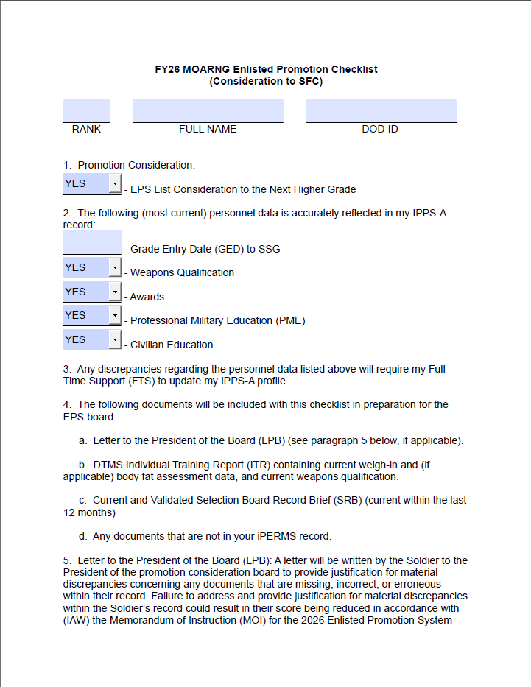
EPS Consideration Step # 4
  Submit consideration packet using the appropriate EPS Checklist located on the MOGUARD website or provided by your FTS

Slide 22
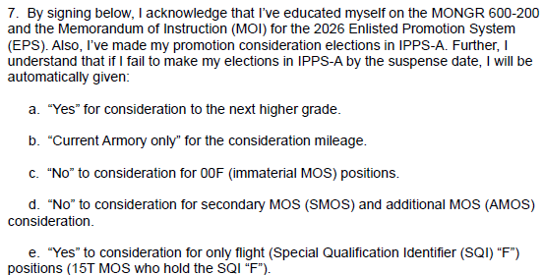
EPS Consideration Step # 4

Slide 23
EPS Consideration Step # 5
  Submit EPS consideration packet to your CoC for 1SG/CSM review and signature
  Follow-up!

Slide 24
EPS Board Purpose
  Evaluate each Soldier using the Whole Soldier Concept with the purpose of establishing a fair and impartial promotion list.

Slide 25
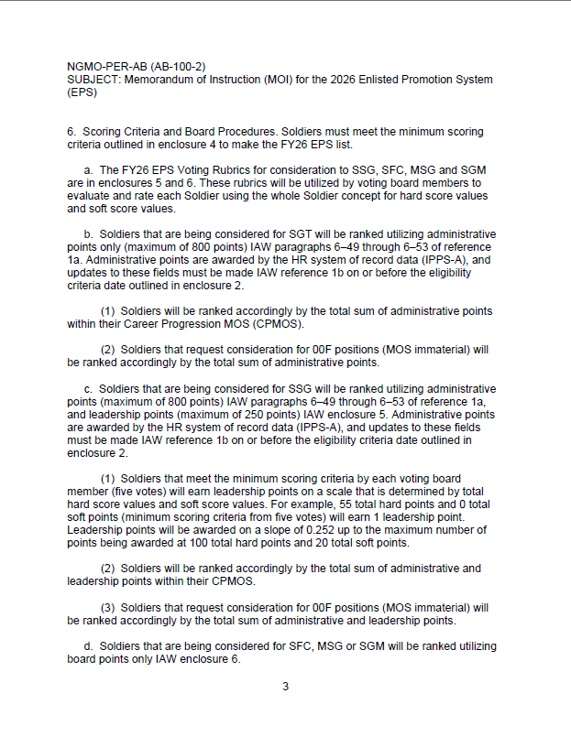
Understanding the EPS Board Process
  FY26 EPS MOI has the detailed scoring criteria broken down by each rank in paragraph 6 and further explained in Enclosure 4

Slide 26
What is the Voting Rubric?
Outlines what the MOARNG is looking for when assessing the top, middle, and bottom rated NCOs within the MOARNG
Published in each annual EPS MOI (Enclosures 5, 6, & 7)
Career progression “Cheat Sheet” readily accessible to all Soldiers
Ensures equitable and consistent assessments are made on all Soldiers’ records that are reviewed

Slide 27
Voting Rubric Scoring
  Minimum score required for making the EPS List to SSG is 8/20 hard points (by each voting member)
  Minimum score required for making the EPS Lists to SFC, MSG and SGM is 9/24 hard points (by each voting member)
  Scoring a “0” in ANY hard score evaluation category will result in not making the EPS list
  Failure to address and provide a letter to the president of the board for material discrepancies within the Soldier’s record could result in the hard score evaluation category rating being reduced by 1 point
  Soft points are totaled and are ONLY utilized whenever there is a tie-breaker situation between hard points of two or more Soldiers (i.e., two Soldiers are being considered for SFC and both score 100/120 hard points)
  ACFT was removed from FY26 EPS Voting Rubrics and AFT will be implemented in FY27

Slide 28
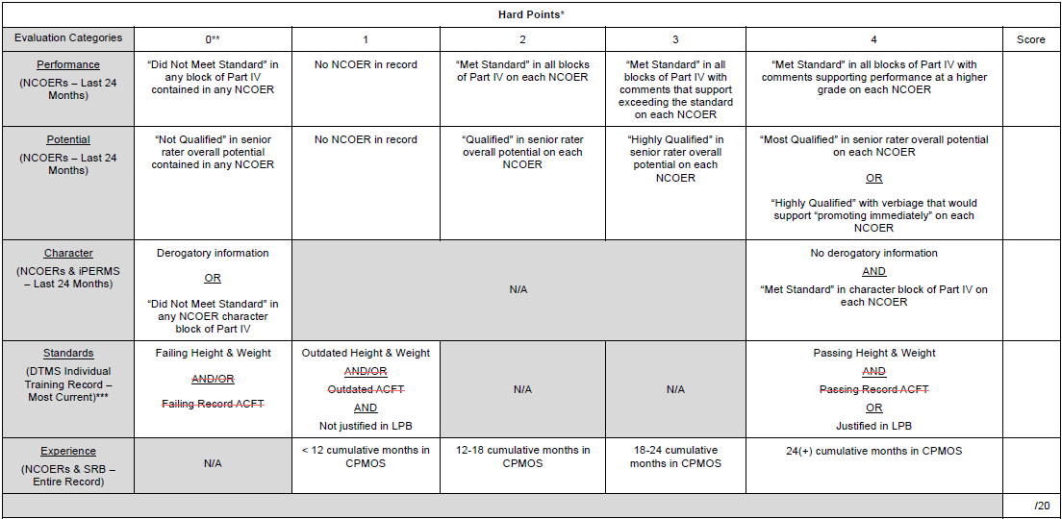
Hard Points (to SSG)

Slide 29
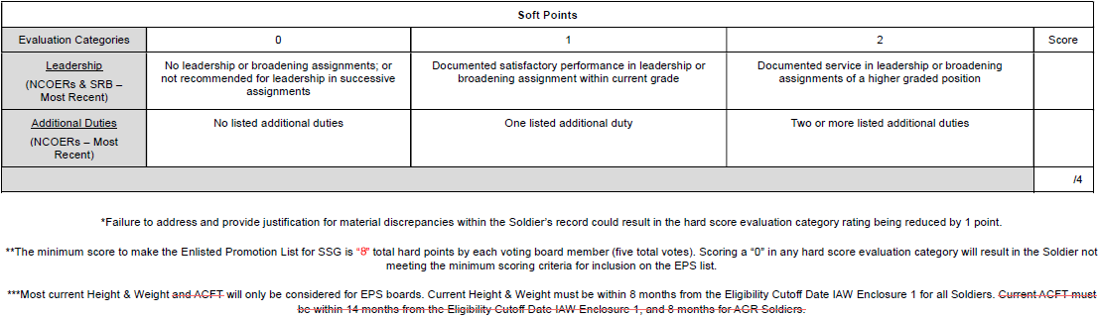
Soft Points (to SSG)

Slide 30
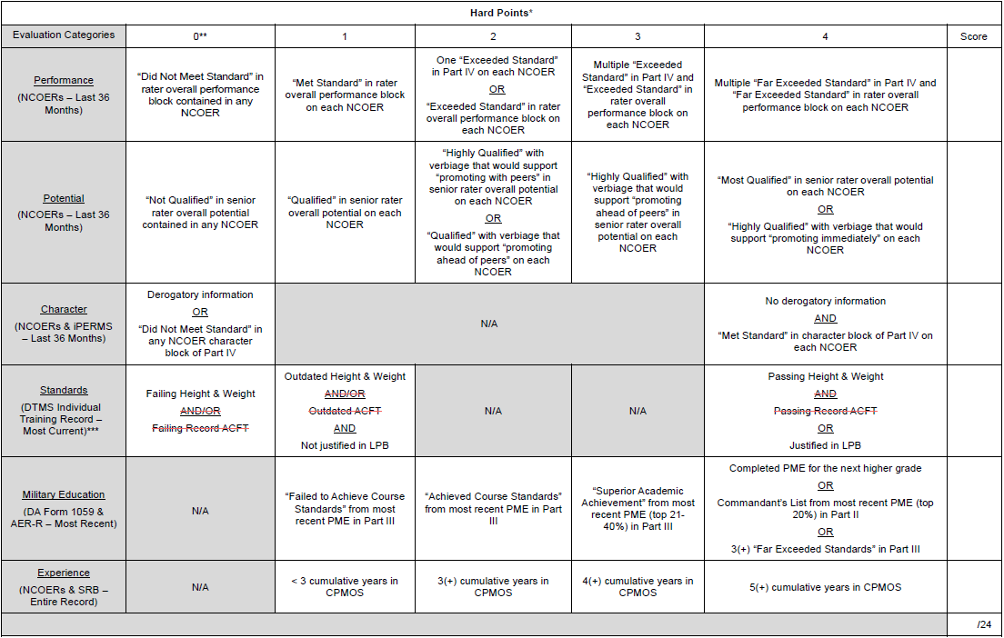
Hard Points (to SFC, MSG and SGM)

Slide 31
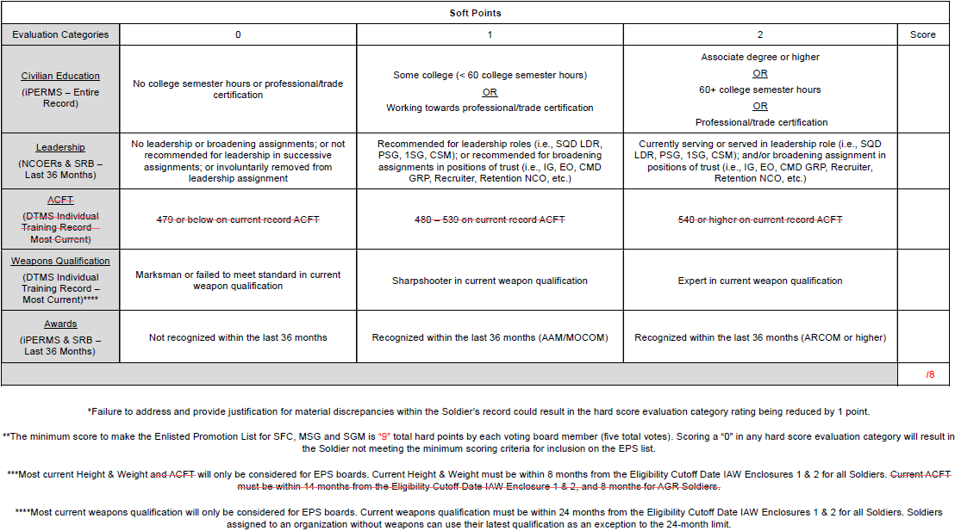
Soft Points (to SFC, MSG and SGM)

Slide 32
AFT Standards
Army Directive 2025-06, Army Fitness Test (17 April 2025)
AFT replaced the ACFT effective 1 June 2025
Traditional (M-Day):
  One per calendar year (conducted every 8 – 14 months)
  Soldiers will not be under adverse actions (FLAG) if failing during transition period (1JUN25 – 31MAY26)
AGR & ADOS:
  Two per calendar year (conducted every 4 – 8 months)
  Soldiers will not be under adverse actions (FLAG) if failing during transition period (1JUN25 – 31DEC25)
  EPS boards will not consider the ACFT in FY26 and the AFT will be implemented in FY27 rubrics

Slide 33
ABCP Standards
Army Directive 2023-08, Army Body Fat Assessment Exemption for ACFT Score (15 March 2023)
Army Directive 2023-11, Army Body Fat Assessment for the Army Body Composition Program (9 June 2023)
Army Directive 2025-02, Parenthood, Pregnancy, and Postpartum (24 February 2025)
All Soldiers:
  Record weigh-in every 6 months (unless exempt under AD 2025-02)
  Soldiers who scored 540+ on ACFT (minimum of 80 points in each event) are exempt from body fat tape assessment until they take an AFT
  EPS Boards have now transitioned to scoring based on the current HT/WT in a Soldier’s record

Slide 34
EPS Board Member Nomination
Reach out to your FLL and FTS to express your interest in participating as a board member in the upcoming EPS boards. Service on the EPS board is one of the most important duties an individual leader performs!

Slide 35
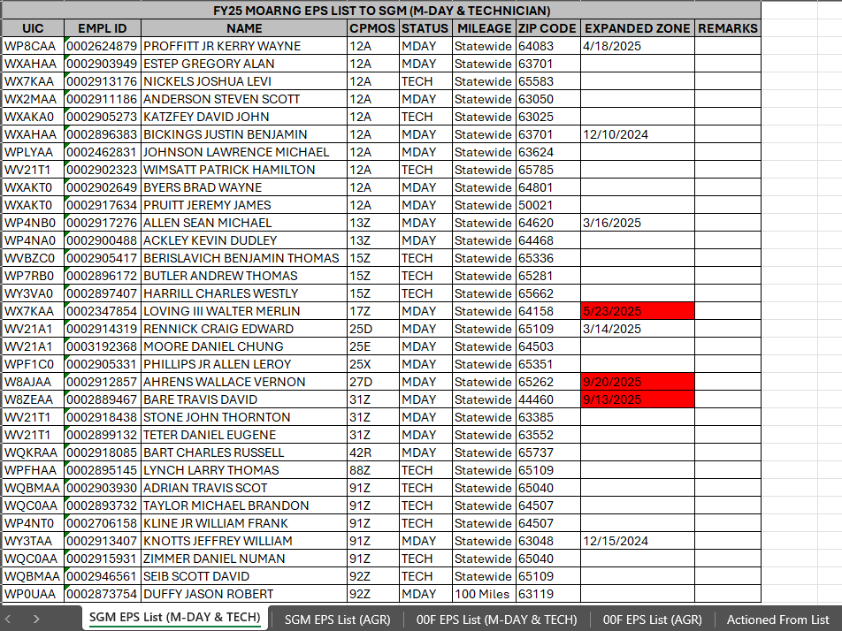
EPS List Content

Slide 36
Suspension of Temporary Promotions
  Temporary promotions were suspended by the Army G-1 on 2 May 2024.
  Implementation guidance from NGB published 7 June 2024.
  Soldiers previously temporarily promoted will not revert to their former grade and are considered “permanently” promoted to their current grade.
  This new policy does not undermine the importance of a Soldier’s attendance to a professional NCOPDS course (Basic Leader Course, etc.).

Slide 37
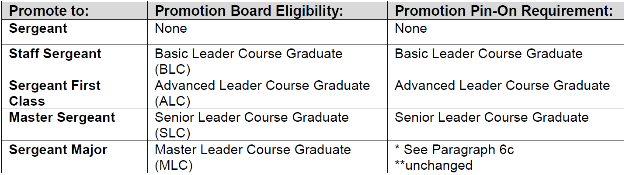
Suspension of STEP Policy
  Select, Train, Educate, Promote (STEP) policy was suspended by the Army G-1 on 4 May 2024.
  Implementation guidance from NGB published 7 June 2024.
  Army will use the updated NCOPDS levels to qualify Soldiers for promotion:

Slide 38
Suspension of STEP Policy
  To emphasize the importance of NCOPDS in sustaining a professional NCO Corps, an additional 150 promotion points will be added to Soldier’s total promotion point score for:
    Soldiers recommended to SGT who are graduates of BLC
    Soldiers recommended to SSG who are graduates of ALC

Slide 39
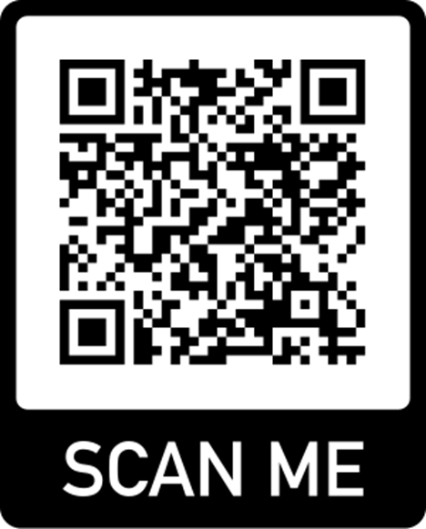
Questions?
Enlisted Actions NCOIC: SFC Ashley Caldwell
ashley.n.caldwell6.mil@army.mil
Enlisted Promotion Manager: SSG Hunter Gladbach
hunter.a.gladbach.mil@army.mil
Assistant Enlisted Promotion Manager: SGT Kendall Kothe
kendall.p.kothe.mil@army.mil

